Slide 1
Take out your 3 C’s work from the previous class
Be ready to discuss what you have written down about tobacco
Scenario: You are at a party and there is tobacco use/ecigarettes/vaping at the party. An upperclassmen approaches you and asks you if you want to try.
Clarify
Consider
The pro’s and con’s
Choose
Why did you believe this was the best choice

Slide 2
Partner up (with an elbow partner) and discuss what might have happened.

Slide 3
Alcohol
FACTS

Slide 5
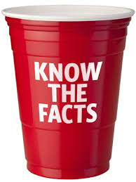
Health Effects (Depressant)
Slows down the brain & body.
Examples:
Loss of coordination
Slowed reflexes
Loss of self control
Poor judgment
Memory lapses
Slurred speech

Slide 6
Health Effects continued
Too much can slow down the body and lead to coma and death.
Alcohol goes directly into your bloodstream and increase your risk for diseases.
Can damage every organ in your body.
If you are with others who are drinking, there is an increased risk of injury, car crashes and violence.

Slide 7
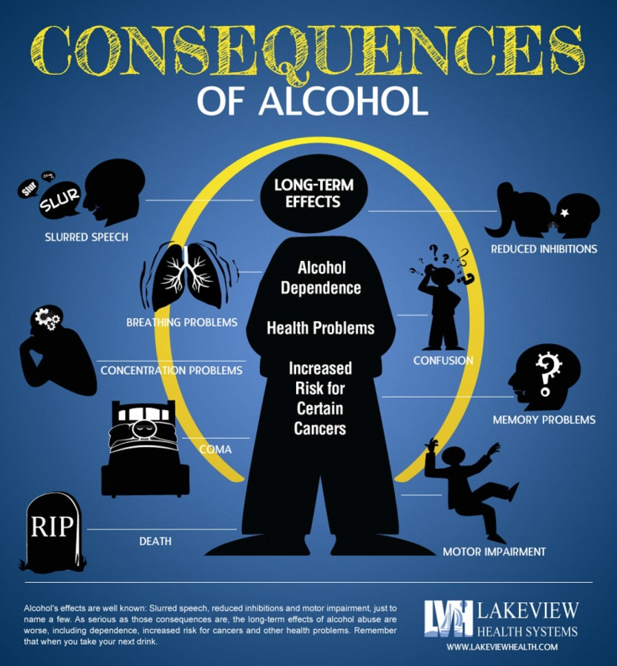

Slide 8
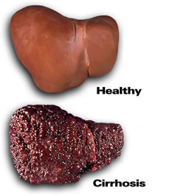

Slide 9
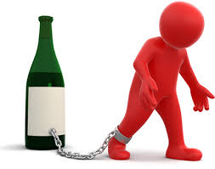
Facts
It is ILLEGAL for anyone under 21
Teen bodies are still growing, therefore alcohol affects them more severely than adults in school and in sports
Become addicted more quickly
Most teens DO NOT drink alcohol
Mixing alcohol with medicine is dangerous
Per serving, beer wine and liquor all contain about the same amount of alcohol

Slide 10
Effects of Drinking On College Aged Students
1,825 college students between the ages of 18 and 24 die (every year) from alcohol-related unintentional injuries, including motor-vehicle crashes.
696,000 students between the ages of 18 and 24 are assaulted by another student who has been drinking.
97,000 students between the ages of 18 and 24 report experiencing alcohol-related sexual assault or date rape.
About 1 in 4 college students report academic consequences from drinking, including missing class, falling behind in class, doing poorly on exams or papers, and receiving lower grades overall. (Why most students drop out of school).

Slide 11
Applying the 3 C’s to a decision involving alcohol.
Scenario: You are hanging out with a friend at their home. A car pulls up and your friend’s older sibling gets out of the car and comes into the house. You quickly notice that the older sibling is behaving oddly (possibly intoxicated) and smells of alcohol. The older sibling grabs their car keys and heads for the door.
Use the 3 C’s and apply them to this situation

Slide 12
3 - 2 - 1 (Note Cards)
3 - What are the 3 C’s of Decision Making?
2 - What are 2 ways that this picture relates to your
learning about alcohol today?
1 - What social impact of alcohol is shown in this picture?

Slide 13
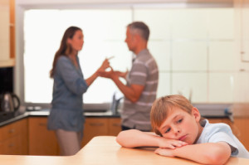

Slide 14
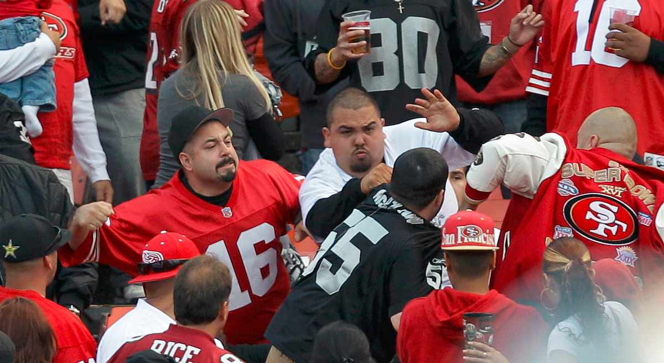

Slide 15
We learned about Tobacco in the last two classes
3 minutes
Elbow partner
Take out a scratch piece of paper
Write down 3 reasons why someone should not use tobacco
Write down 3 things you would say to someone to get them to quit using tobacco
You answer cannot be you “can die” or “it is bad for you”...we already know that

