Slide 1
Exercise and Fitness
Have a heart…and keep it
healthy!

Slide 2
Finding your heart rate--(Count pulse for 6 seconds and add a 0)
Carotid artery
Radial Ulnar artery

Slide 3
Resting Heart Rate--Your heart rate when you are at rest
A good indicator for your overall health
-The lower your resting heart the better your health is
-A normal range would be between 60-100
-An average resting heart rate for teens is between 66 and 72 beats per minute
Who do you think has the lowest RHR? (Which type of athlete?)
How do you get a low or lower RHR?

Slide 4
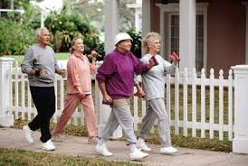
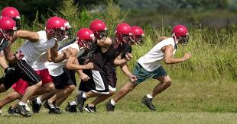
Max Heart Rate--The fastest your heart is able to beat
How to calculate your max heart rate:
220 - your age = max heart rate
Example: 220 - 13 = 207 (max heart rate)
**We use max heart rate to help exercise at a specific intensity**
People exercise at different intensities to achieve desired results (NEXT SLIDE)

Slide 5
Target Heart Rate
A specific, age-based heart rate to be maintained during exercise to ensure optimal cardiovascular function
An optimal heart rate at which a person should perform to achieve desired results

Slide 6
TARGET HEART RATE ZONES
Ideal For | Benefit Desired | Intensity Level (% Maximum heart rate)
Light Exercise (healthy heart zone) | Maintain Healthy Heart/Get Fit | 50% - 60%
Weight Management (fitness zone) | Lose Weight/ Burn Fat | 60% - 70%
Aerobic Base Building (aerobic zone) | Increase Stamina Aerobic Endurance | 70% - 80%
Optimal Conditioning (anaerobic zone) | Maintain Excellent Fitness Condition | 80% - 90%
Elite Athlete | Maintain Superb Athletic Condition | 90% - 100%

Slide 7
What are the benefits of each of the zones?
Light Exercise (50-60% of Max Heart Rate)
(healthy heart zone)
-not intense enough to gain cardiovascular benefits/fitness
-low risk of injury
Weight Management (60-70% of Max Heart Rate) (fitness zone)
-slight gain cardiovascular fitness
-Targets fat burning
Aerobic Base Building (70-80% of Max Heart Rate) (aerobic zone)
-significant gain in cardiovascular fitness
-good for training if you are out of season
-resting heart rate will start to decrease
Optimal Conditioning (80-90% of Max Heart Rate) (anaerobic zone)
- extraordinary gain in cardiovascular fitness
-good for in season training
-resting heart rate will start to decrease

