Slide 1
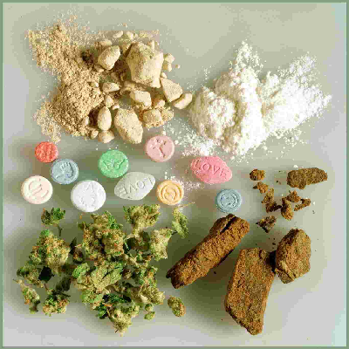
Drugs & Drug Abuse

Slide 2
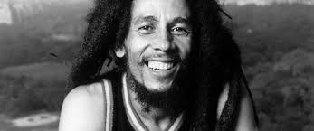
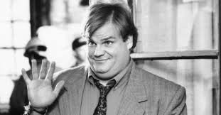
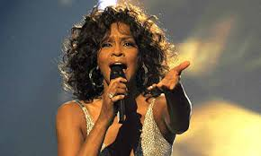
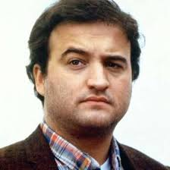
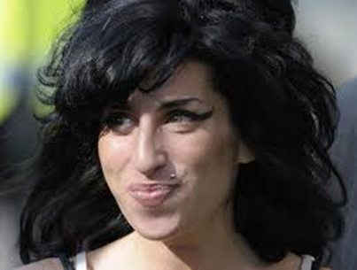
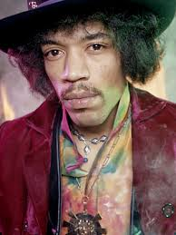
How different would our world be if these people hadn’t overdosed on drugs

Slide 3
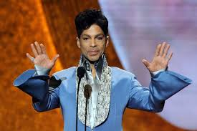
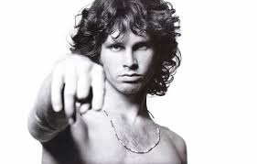
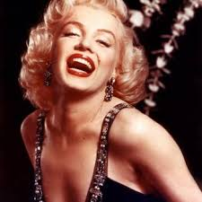
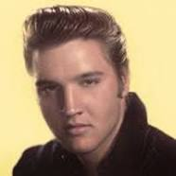
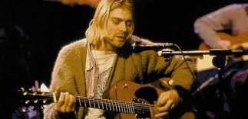
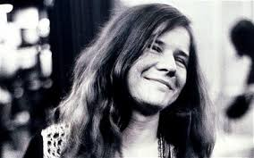
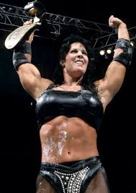
How different would our world be if these people hadn’t overdosed on drugs

Slide 4
Objectives
Know what constitutes drug abuse & drug use
Become familiar with drugs and their effects

Slide 5
Who it affects…
Drug abuse affects everyone.
Drug users have been surveyed as using twice the medical benefits of a non-drug user, taking 1/3 more leave time, and are 60% more likely to be responsible for an accident.
Illegal drug users are far more likely to be involved in domestic abuse, violent altercations, and other crimes.

Slide 6
Taking action…
Even if you do not do drugs, it is important that you know the dangers of substance abuse in order to better understand how they affect our fellow family members, peers, and teammates.
If you know a friend/peer that is having a problem with drug abuse, it is in his or her best interest to seek immediate help.

Slide 7
Drug abuse/Drug use
Drug abuse-- involves use, possession, manufacture, or distribution of a controlled substance.
Drug use-- encompasses all methods of introducing a drug into the body (i.e. inhaling, injecting, ingesting, etc.)

Slide 8
Iowa High School Drug Stats
(grades 9-12)
MARIJUANA USE AMONG HIGH SCHOOL STUDENTS – 28%
COCAINE, HERION, & METHAMPHETAMINE USE AMONG HIGH SCHOOL STUDENTS -- 3%
NONMEDICAL USE OF PAIN RELIEVERS – 6%
EVERYONE IS NOT DOING IT!!!!

Slide 9
Here are a few realities to consider when discussing drugs
You can’t predict the effect that a drug can have on you—especially if it’s the first time you try it, and even if it’s a small amount or dose. Everyone's brain and body chemistry are different. Everyone's tolerance for drugs is different.
Using drugs can lead to abuse, addiction, serious health problems, and even death.
Drugs that are legal—prescription and over-the counter (OTC) medications—can be just as dangerous as illegal drugs.

Slide 10
Types of Drugs
The following are among the most frequent
misused substances in the world today:
Tobacco
Alcohol
Prescription Drugs
Methamphetamine
Marijuana
MDMA (Ecstasy)
Crack Cocaine
Heroin
Steroids
Inhalants

Slide 11
Marijuana (the gateway drug)
Street name: Pot, Grass, Weed, Mary Jane, Reefer
The most commonly used illicit drug in America today.
A tobacco-like substance produced by drying the leaves and flowering tops of the cannabis plant
Is usually smoked in the form of loosely rolled cigarettes (joints) or hollowed-out commercial cigars (blunts).

Slide 12
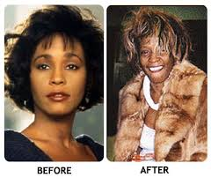
Before/After drug use

Slide 13
Marijuana: Side Effects
Marijuana contains known toxins and cancer-causing chemicals that are stored in fat cells of users for up to several months.
Marijuana users experience the same health problems as tobacco smokers, such as lung cancer, bronchitis, emphysema, and bronchial asthma.
Some side effects include increased heart rate, dryness of the mouth, reddening of the eyes, impaired motor skills and concentration, and frequent hunger.

Slide 14
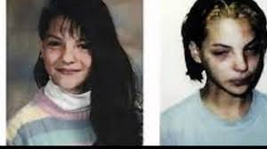
Before/After Continued

Slide 15
Health Effects
Marijuana affects your brain and body.
Examples are:
Short term memory loss
Loss of the ability to concentrate
Slow coordination and reflexes
Affects your ability to judge distance, speed and reaction time – These are important in sports or even riding a bike.

Slide 16
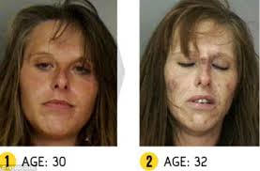
Before/After Continued

Slide 17
Facts about use
Marijuana can be addictive. (National Institute on Drug Abuse)
There is more tar in marijuana smoke than in tobacco smoke.
Marijuana users have an increased risk of cancer.
Marijuana smoke contains 50% to 70% more of some cancer causing chemicals than tobacco smoke.
Marijuana is ILLEGAL in the United States.

Slide 18
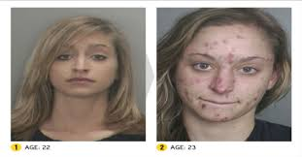
Before/After Continued

Slide 19
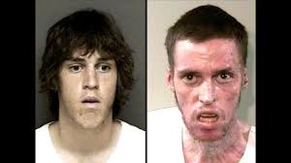
Before/After Continued

Slide 20
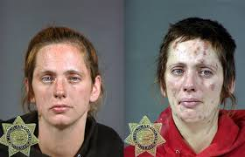
Before/After Continued

Slide 21
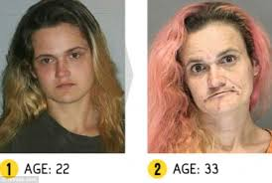
Before/After Continued

Slide 22
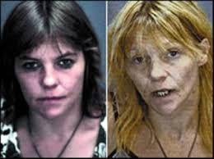
Before/After Continued

Slide 23
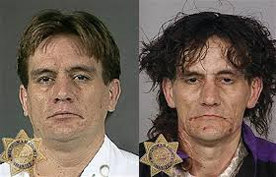
Before/After Continued

Slide 24
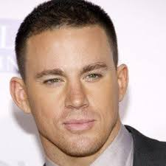
Before/After Continued

Slide 25
Questions? Concerns? Anxieties?

