Slide 1
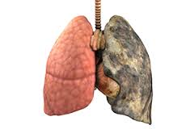
DISCUSS YOUR THOUGHTS (ABOUT THIS SET OF LUNGS) WITH AN ELBOW PARTNER

Slide 2
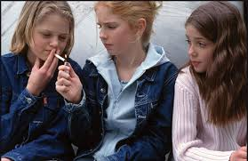

Slide 3
TOBACCO
WHAT YOU NEED TO KNOW

Slide 4
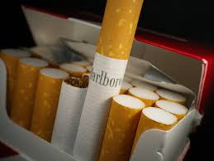
TOBACCO HEALTH EFFECTS
Smoking can cause:
-Breathing problems
-Frequent colds
-Upper respiratory problems
-Heart disease
-Cancer (lung, mouth, throat, kidney, bladder)
Smokeless tobacco can cause:
-bad breath, tooth loss, mouth cancer, and other health probems

Slide 5
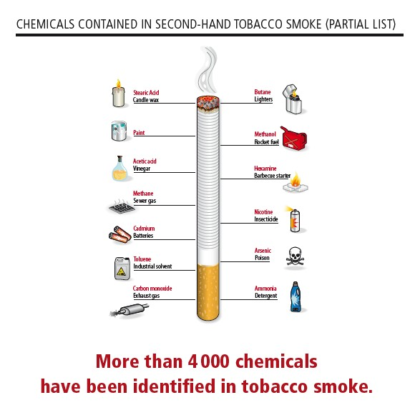
OTHER EFFECTS
Tobacco
-negatively effects your bodies development
-has nicotine (an addictive drug) in it
-200 known poisons and 4,000 chemicals cigarette smoke
-Dry out your skin, cause wrinkles, yellow teeth
-Smoking is the leading preventable cause of death in this country
More than 6,000,000 Americans die from tobacco-related causes each year
Most of those above started using tobacco before the age of 18 (it is illegal to buy tobacco under the age of 18)

Slide 6
Why Do Tobacco Companies Want Young People To Smoke?
“Today’s teenager is tomorrow’s potential regular customer, and the overwhelming majority of smokers first begin to smoke while still in their teens.” — Philip Morris, 1981.
-95% of people who smoke start before they are 18
-Teens are much more likely to become addicted
-Adult consider health much more and resist smoking
-5 % of smokers start after 18

Slide 7
How Do Tobacco Companies Target Kids
Elbow partner and come up with a few ways that tobacco companies target kids
Be specific

Slide 8
How Do Tobacco Companies Target Kids
If you see tobacco ads in your family’s magazines
Tobacco advertising (in stores) within children’s view (eye level of three feet or below), and away from candy displays.
If you see candy cigarettes, bubble gum cigars or other tobacco look-a-like items being sold these products send the message to kids that smoking is fun.
If you see smoking depicted in movies rated G, PG or PG-13

Slide 9
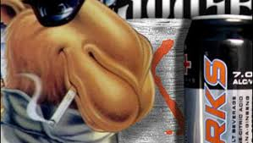
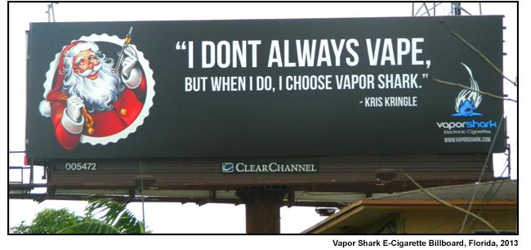

Slide 10
MYTH: LIGHT SMOKING IS OKAY
WRONG!
FACT: Even one cigarette is bad for you. Light smokers and intermittent smokers face future health risks. And light smoking may lead to heavy smoking over time.

Slide 11
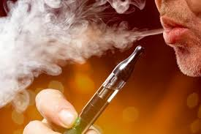
E-CIGARETTES (ELECTRONIC CIGARETTES)
-Contain nicotine (an addictive drug)
-May be dangerous to people with heart problems
-Can harm your arteries over time
-Users have long term breathing problems
-Smoking an e-cigarrete creates particles that get stuck deep in your lungs
Chemical found in e-cigarretes :
Anti-freeze (coolant found in cars), copper, nickel, tin, and other cancer causing chemicals

Slide 12
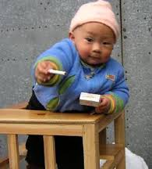
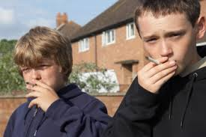
ASK YOURSELF: WHAT DO TOBACCO COMPANIES WANT YOU TO BELIEVE?
Facts
-(they are owned by big tobacco companies)
-Tobacco is responsible for 6 millions death per year
-Tobacco companies need to replace 1,200 individuals who die each day – so they recruit teenagers.
-Why teenagers? FACT- If you don’t start smoking by age 19, you are very unlikely to ever become a smoker
-Because e-cigs teach teenagers how to smoke and they may become addicted to nicotine, this may cause teenagers to move on to smoking regular cigarettes

Slide 13
What Kids Say About Tobacco Article
Elbow partner
Read “What Kids Say About Tobacco” with partner, discuss questions with partner, discuss questions with another pair (stand up meetings)
Read “The Question of Cool” with partner, discuss questions with partner, discuss questions with another pair (stand up meetings)

